Slide 2
BG: what is input data
1 plots Az vs time + temps vs time over 5 min for few + elvation
2 for one Az file (scatter)
3.0 data check how many line to time
hist line and time
good data break 5 min
3 record median ave max min std (good) number of data point time for data files (time format: ctime)
3.1summary file with {filename} npy vs csv time and space
3.2→ during am run
4(further) overview slides
how line of sight to zenith

Slide 3
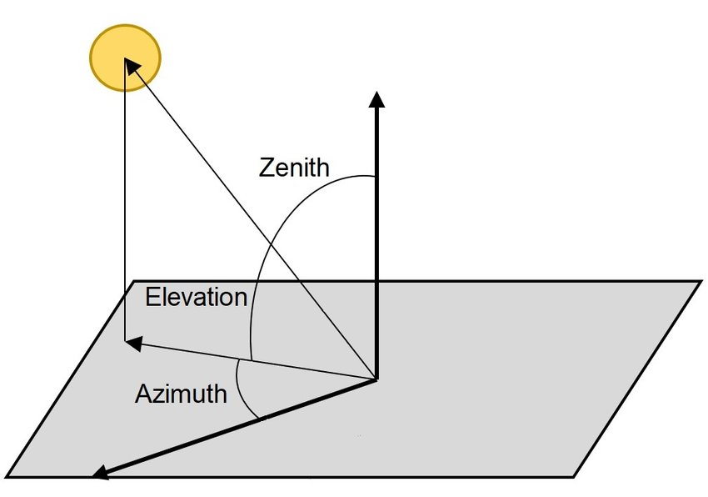
What I used in data
TIME …… TSRC0 TSRC1 TSRC2 TSRC3 EL AZ
2024-06-12T19:01:36.642127 …… 64.9747390747 34.9560852051 21.7463874817 16.6668453217 55.0 2.625
TIME
TSRC0 TSRC1 TSRC2 TSRC3 : the observing temperature
EL
AZ

Slide 4
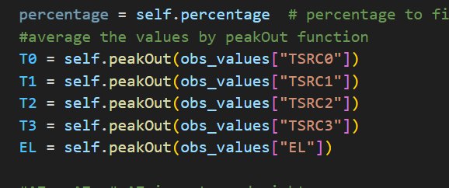
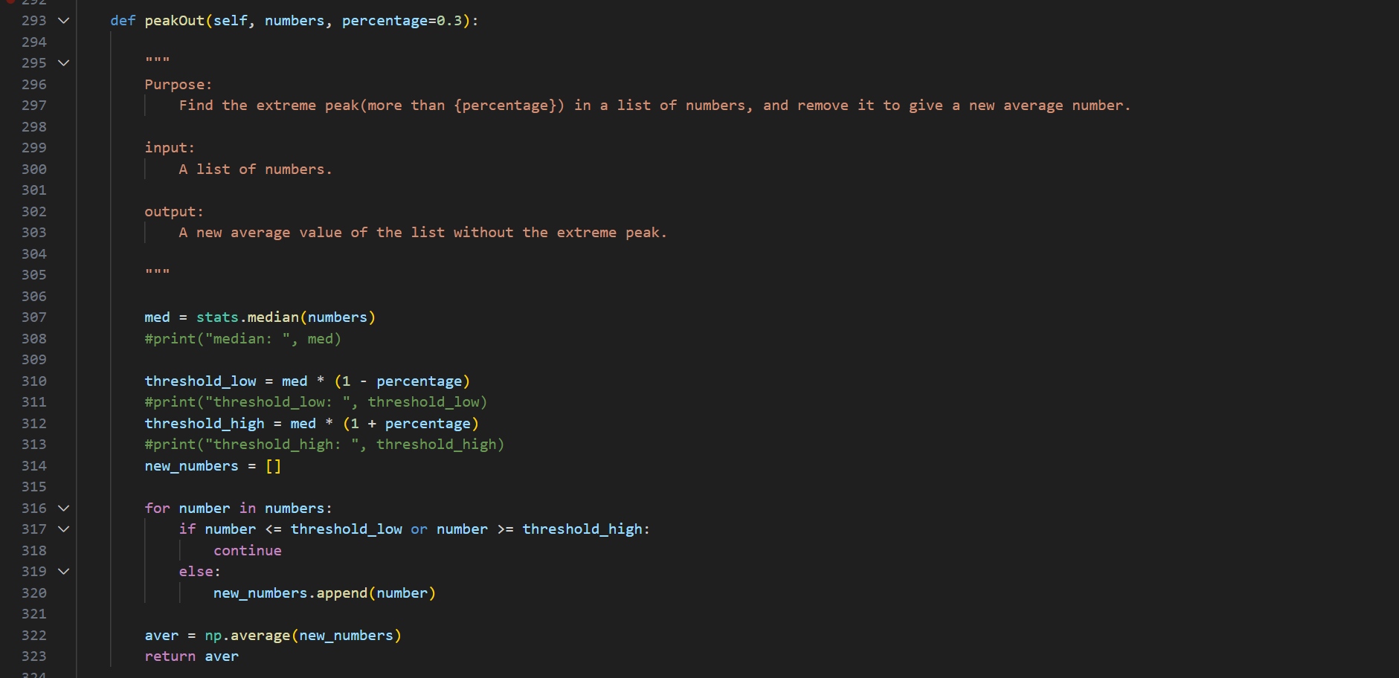
How avg

Slide 5
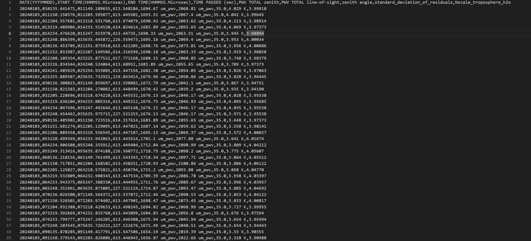

Slide 6
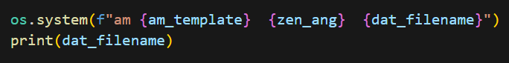
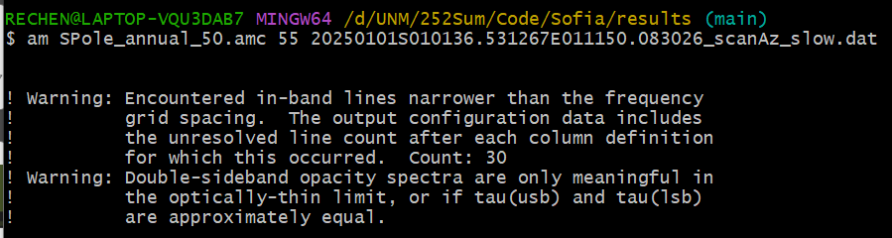
am fitting
=
The first warning seems to happen mostly in the mesosphere and stratosphere, rather than in the troposphere. Therefore, the pwv should have a very low influence.
The second warning is about the output tau, which we did use.

Slide 7
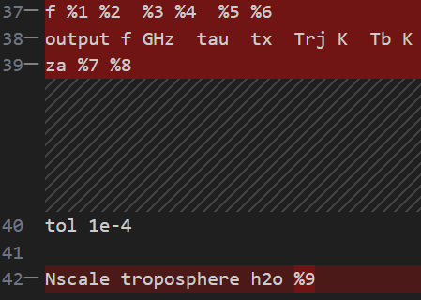
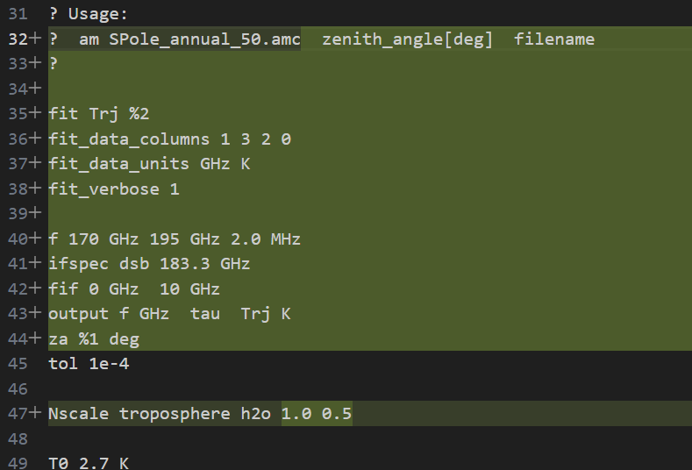
What’s the different of am fitting file
From am Cookbook
From Sofia’s code GitHub:
WVR-pipeline/ Templates/SPole_annual_50.amc

Slide 8
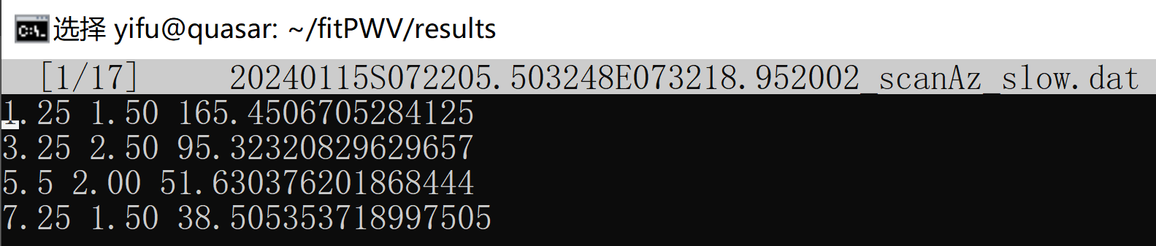

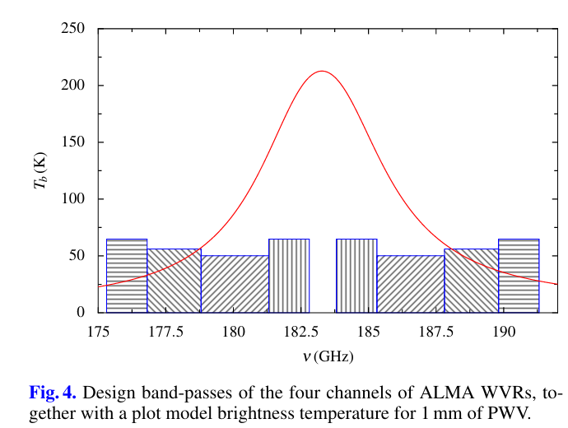
am fitting
From amc, we expect the dat file as
frequence(v_i) bandwith(b_i) spectral data (s_i)
So, the dat is means:
observing 184.55(183.3 + 1.25) GHz, the bandwidth is 1.50 GHz, spectral data is the observing temperature
From B.Nikolicetal.:PhasecorrectionforALMAwith183GHzwatervapourradiometers, 2013

Slide 9
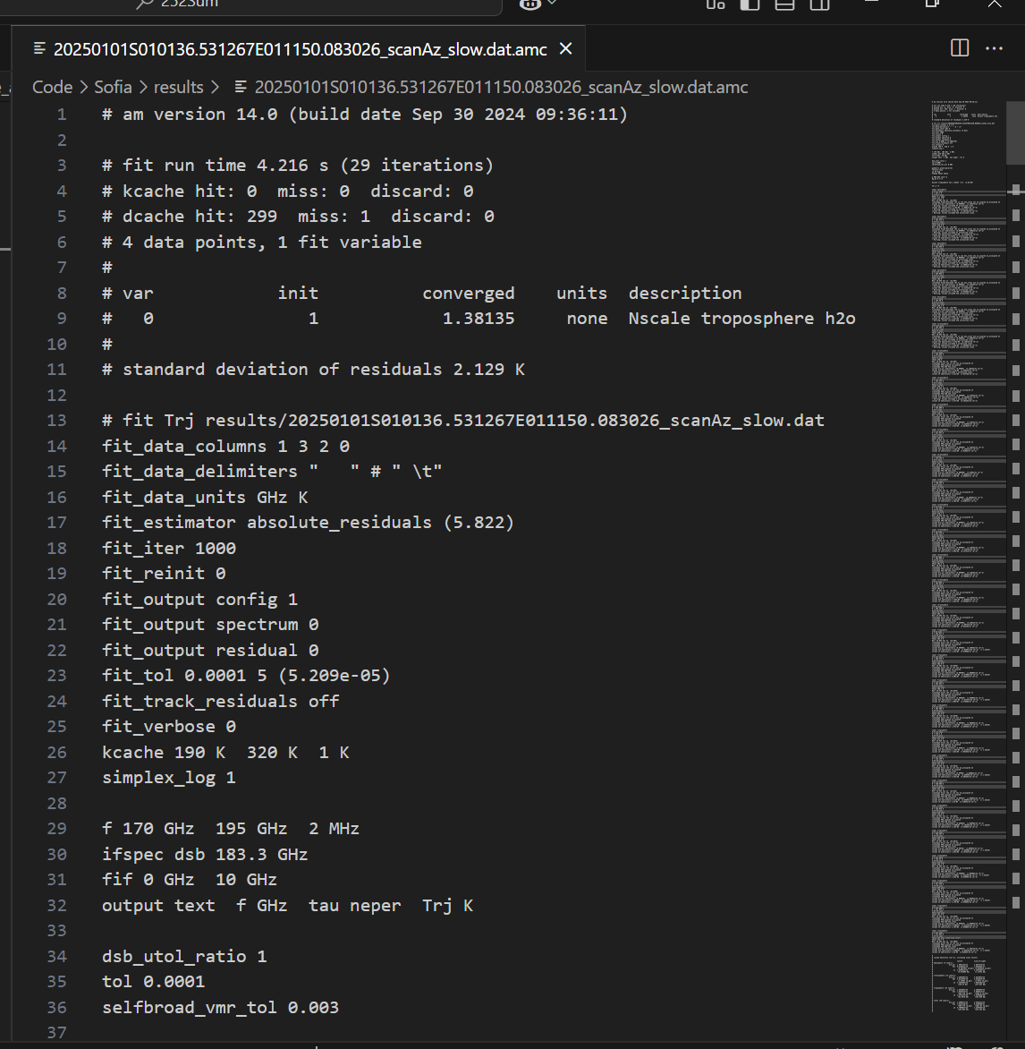
Output amc file

Slide 10
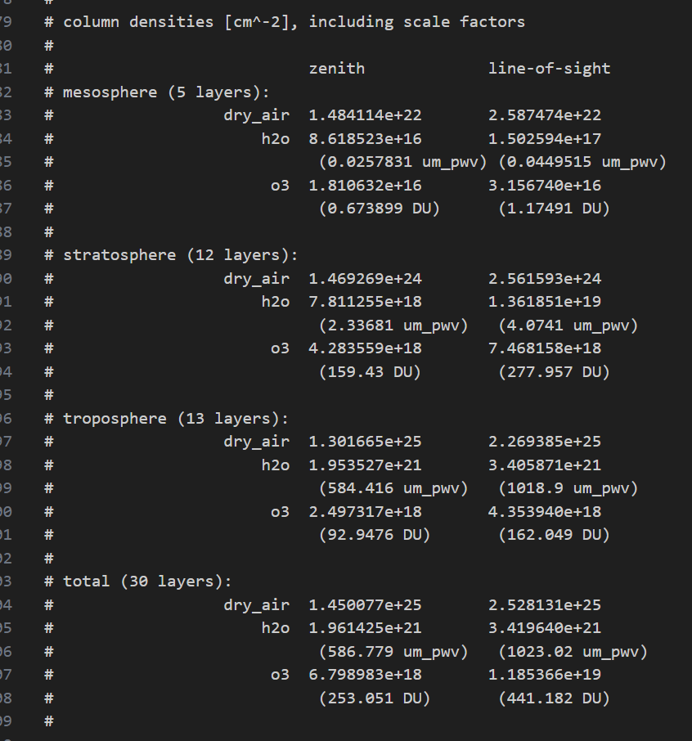
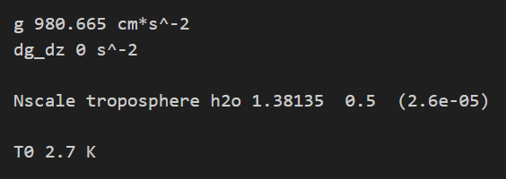
Output amc file

Slide 11
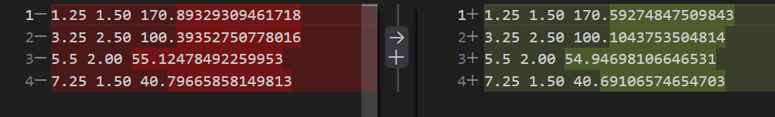
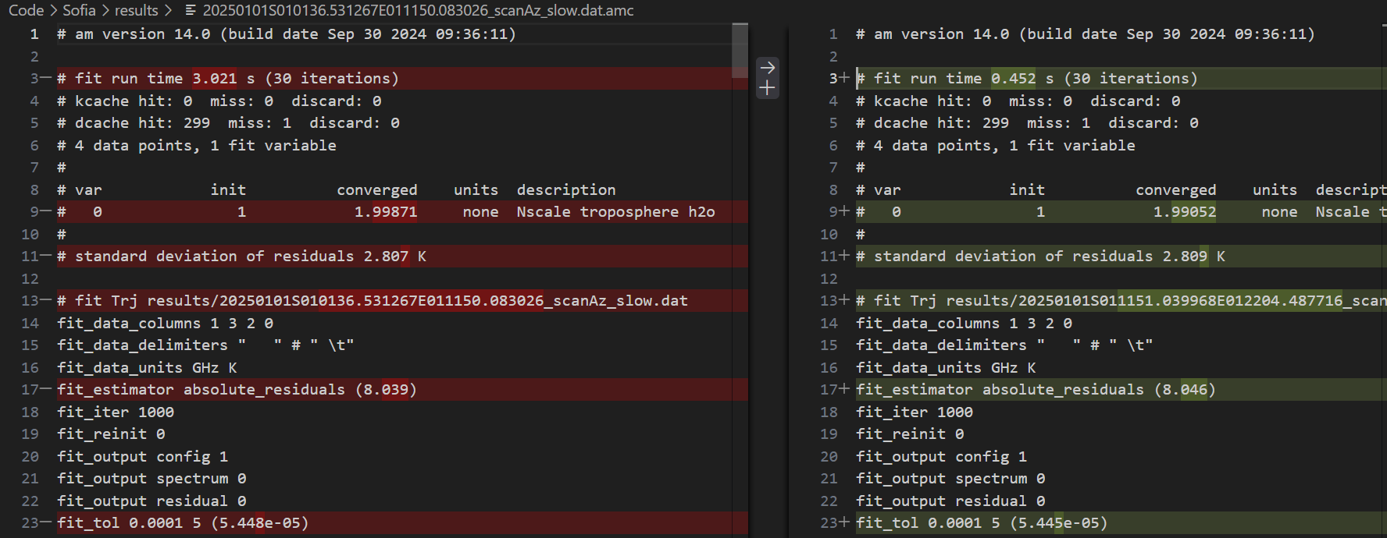
Compare Data 20250101 010136.531267 to 011150.083026 and 20250101 011151.039968 to 012204.487716
The output amc different:

Slide 12
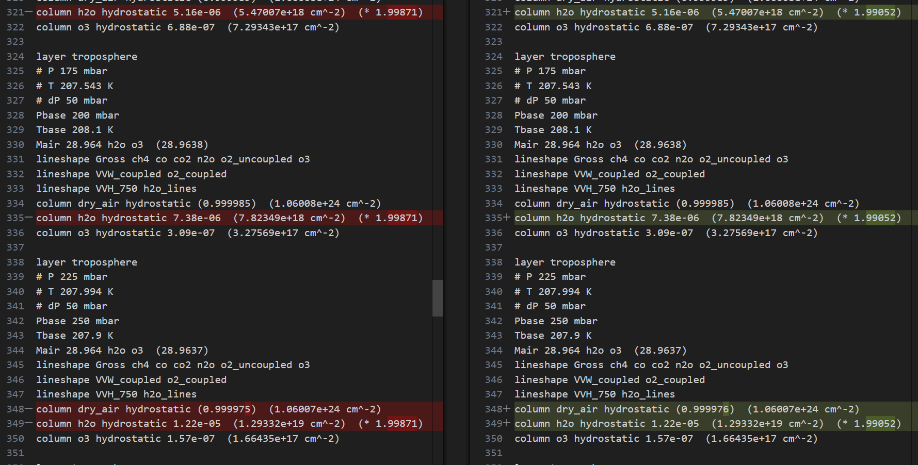

Slide 13
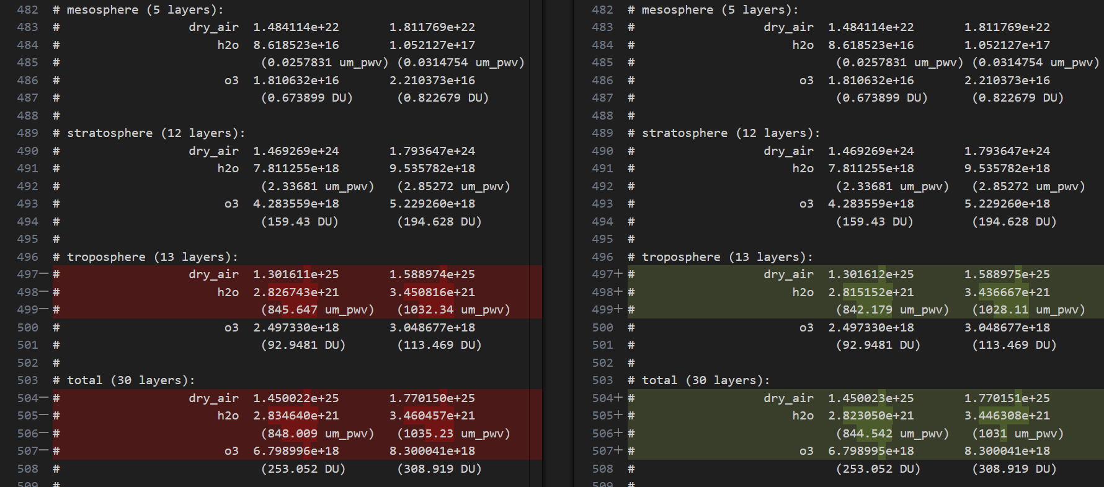

Slide 14
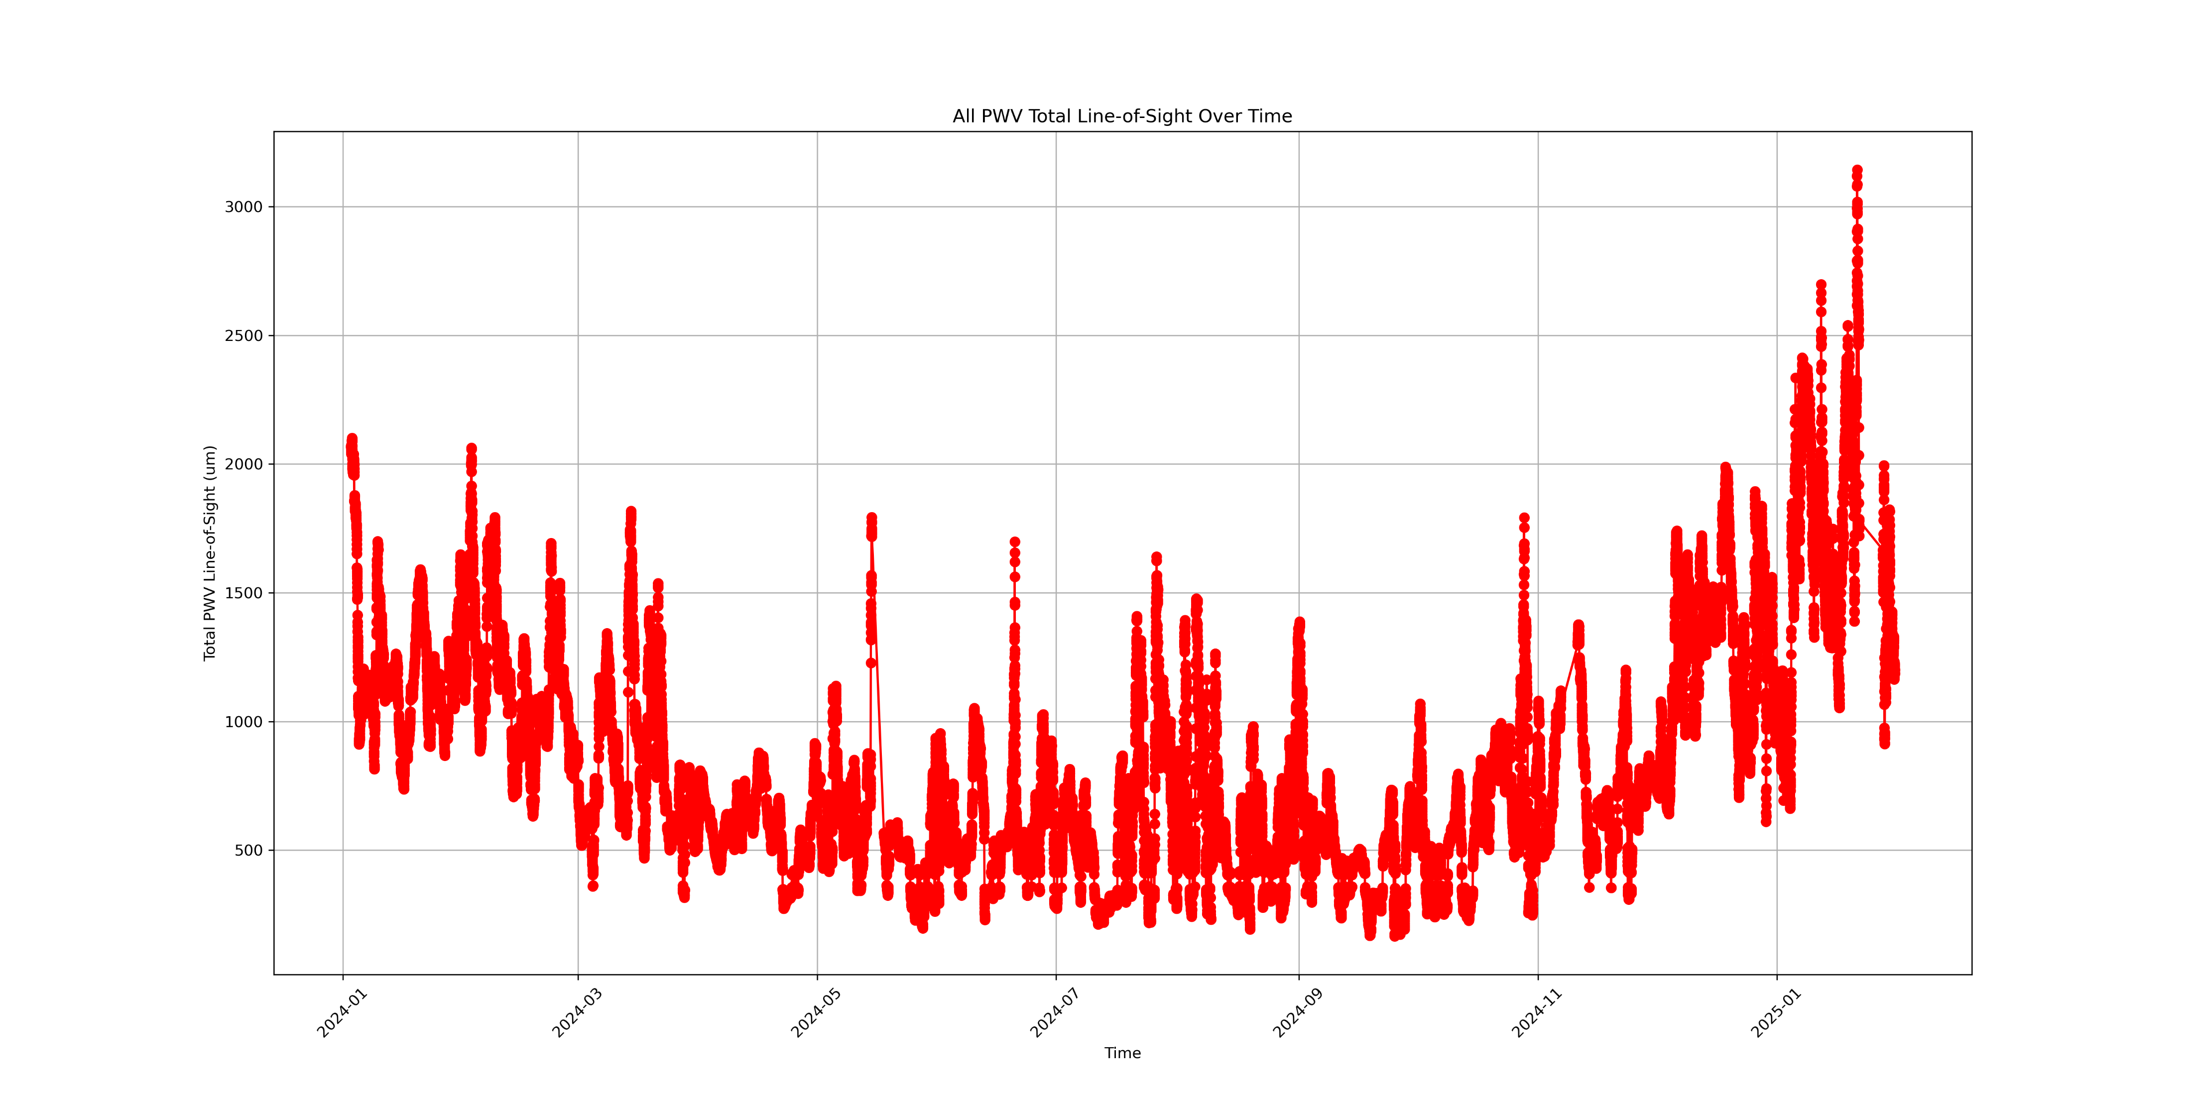

Slide 15
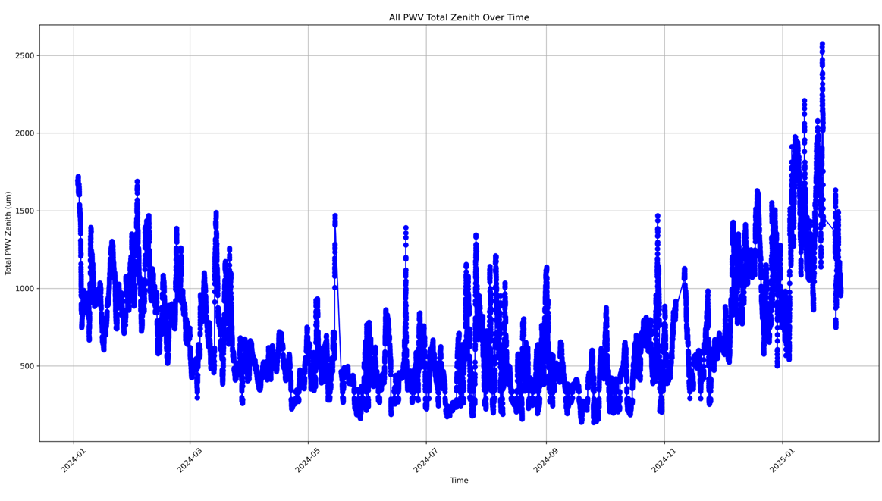

Slide 16
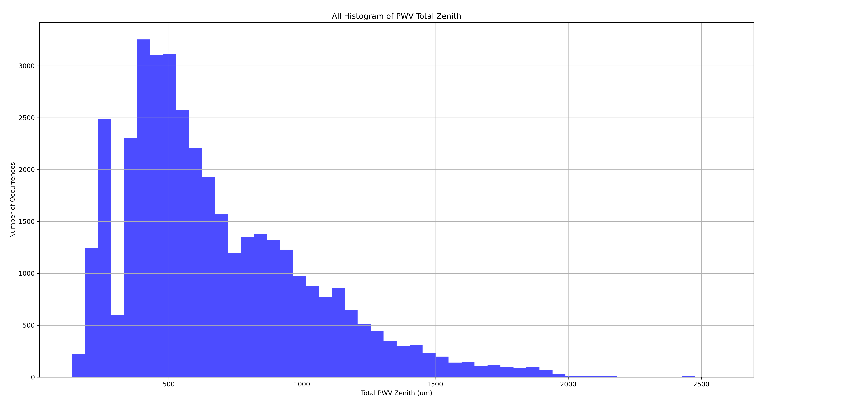

Slide 17
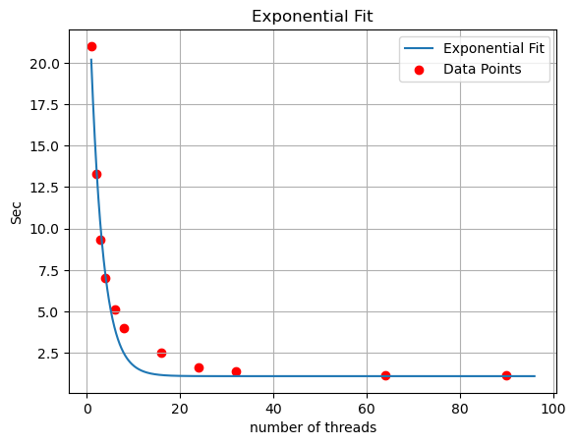

Slide 18
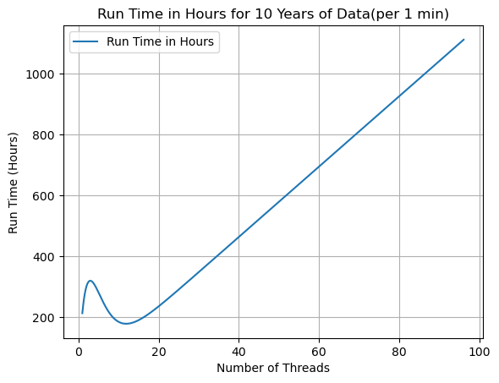

Slide 19
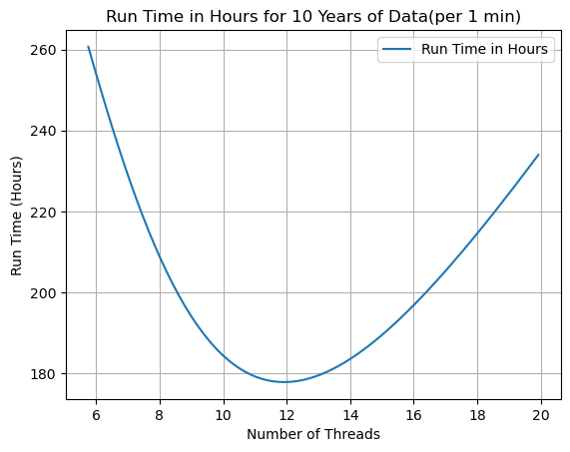

Slide 20
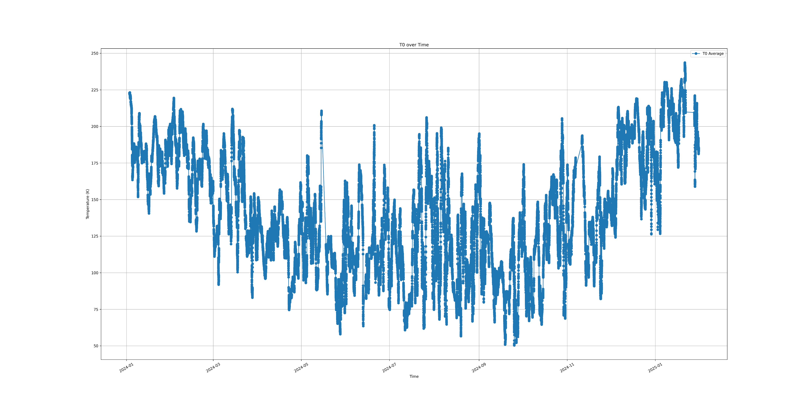

Slide 21
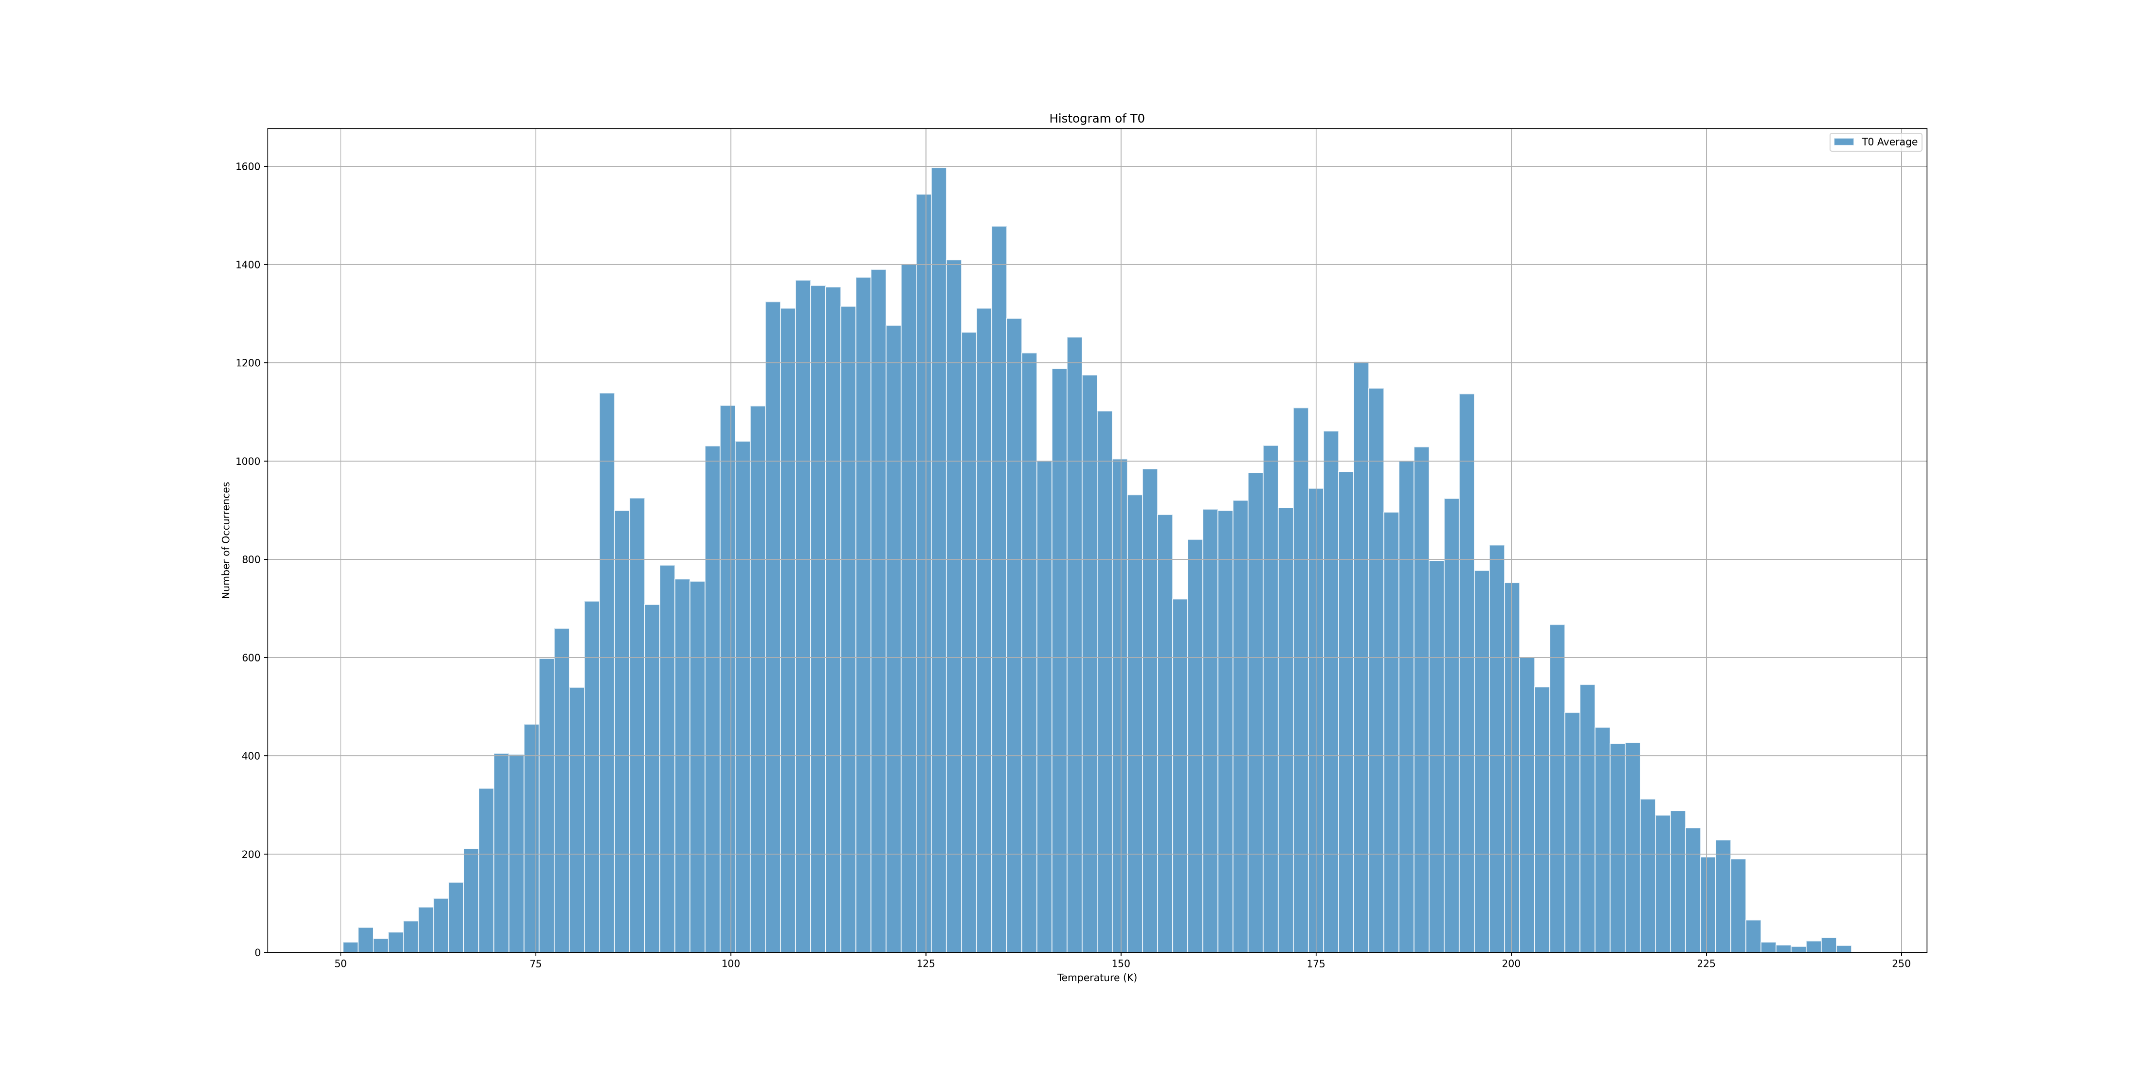

Slide 22
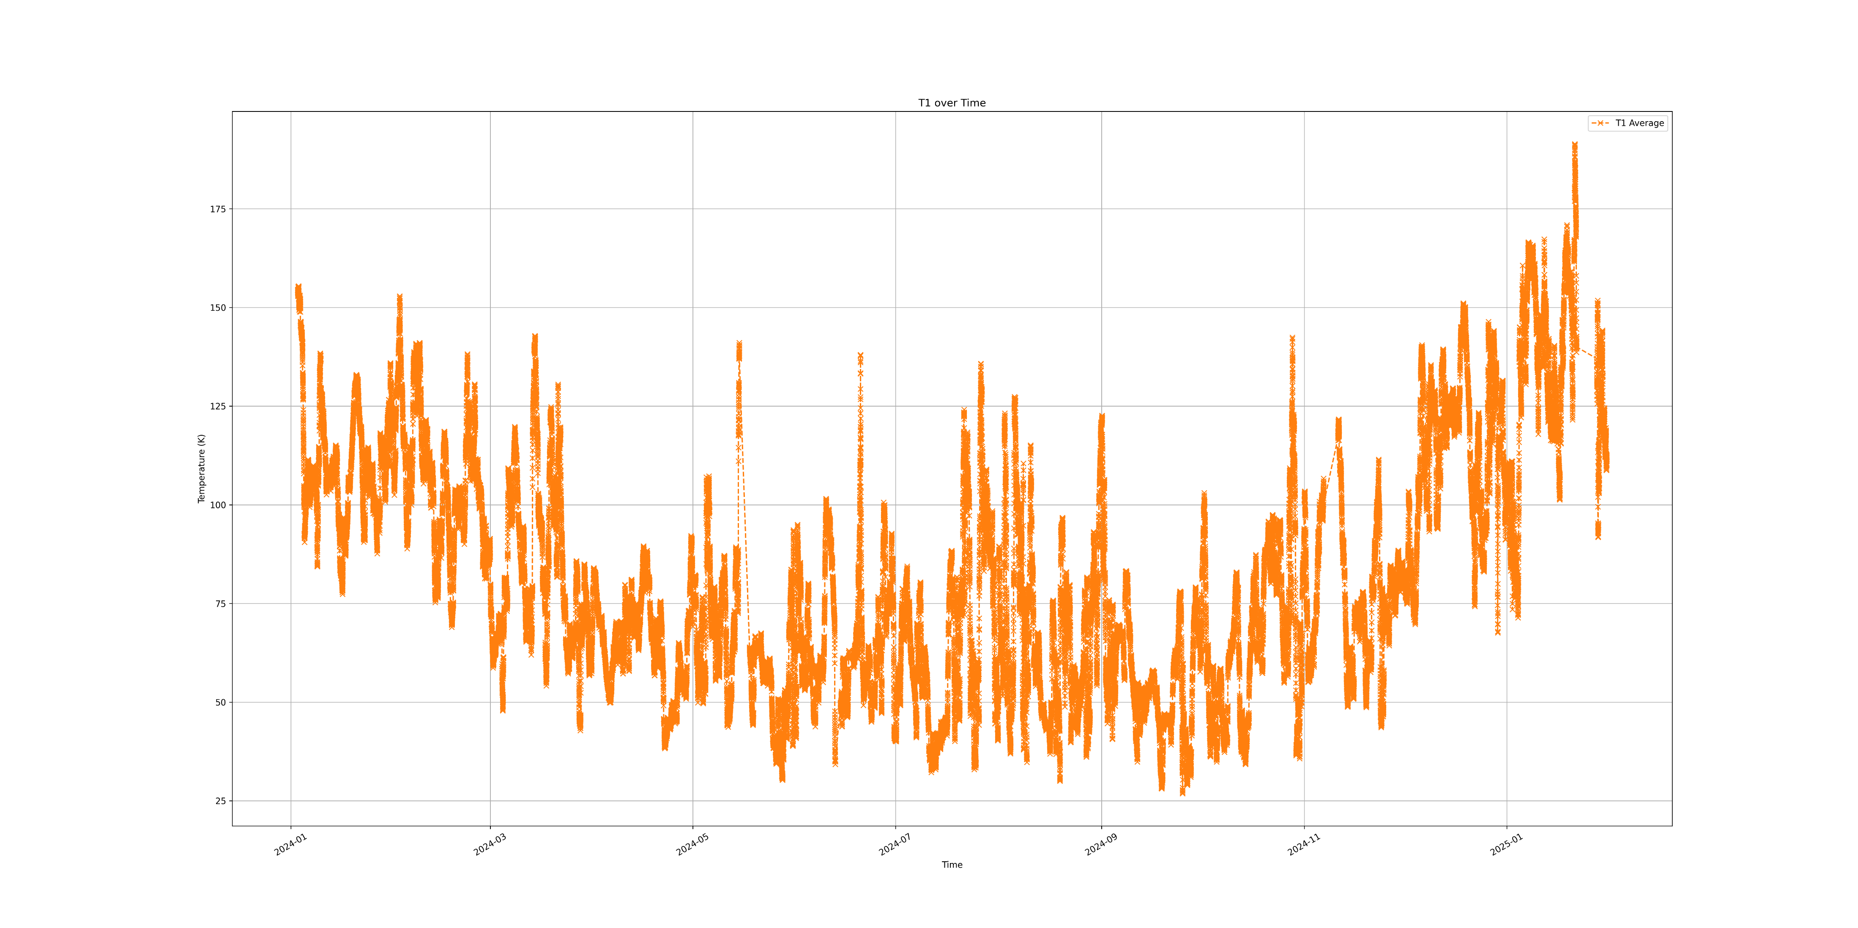

Slide 23
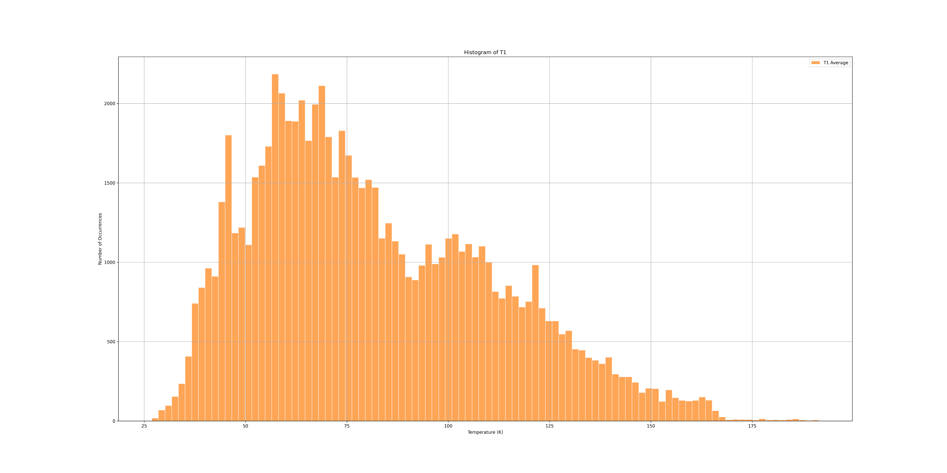

Slide 24
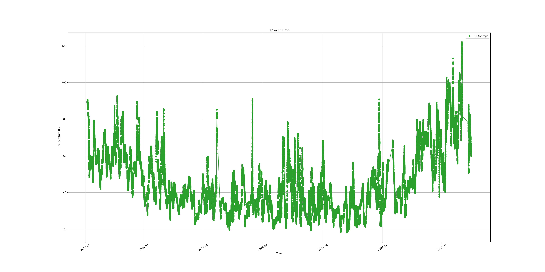

Slide 25
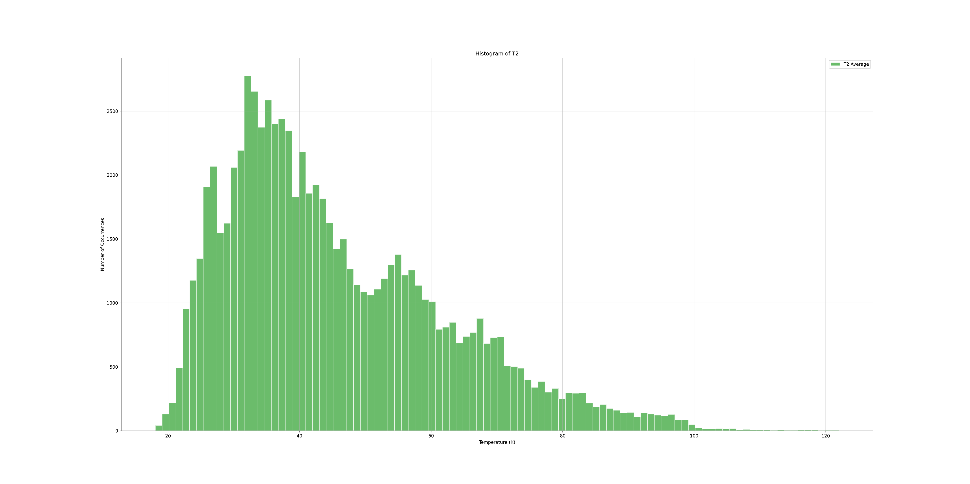

Slide 26
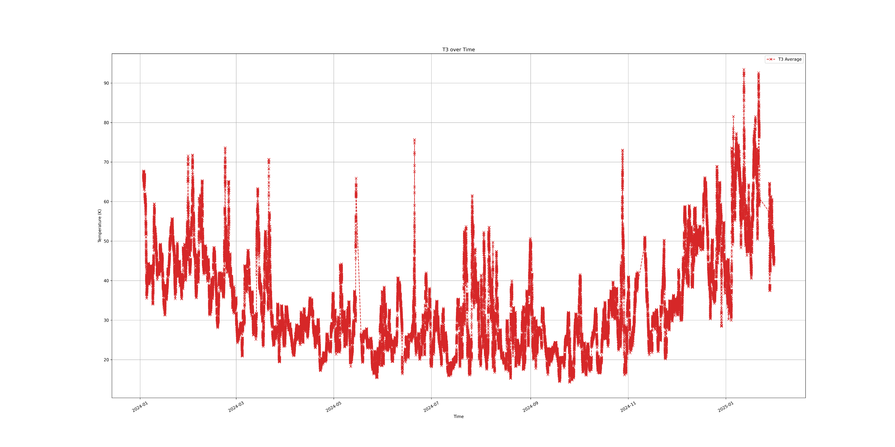

Slide 27
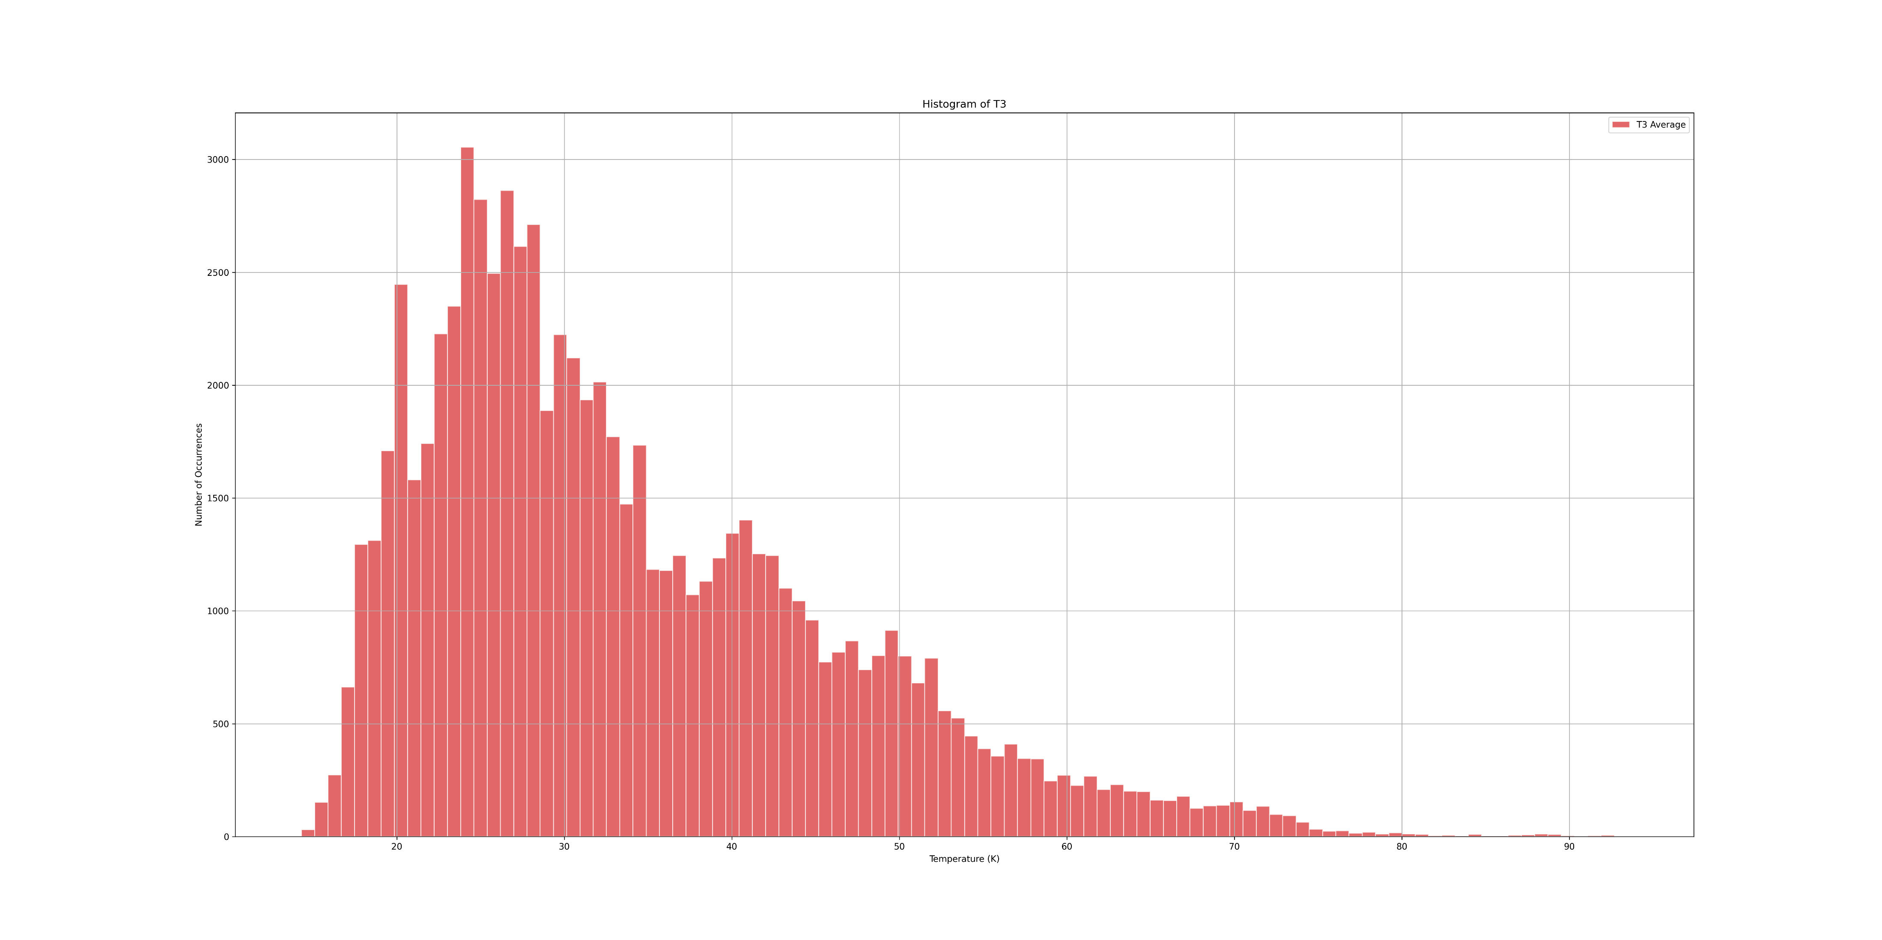

Slide 28
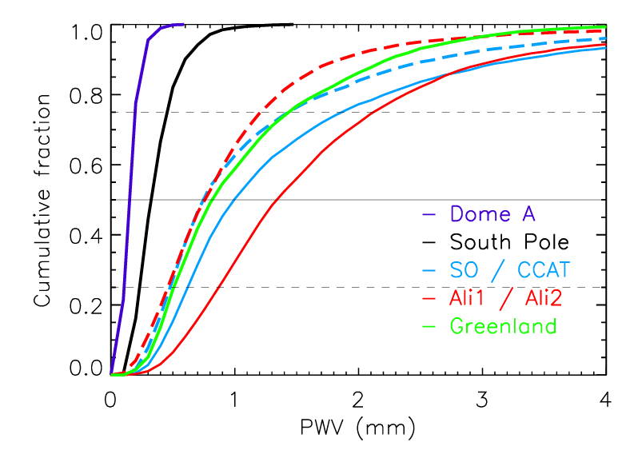
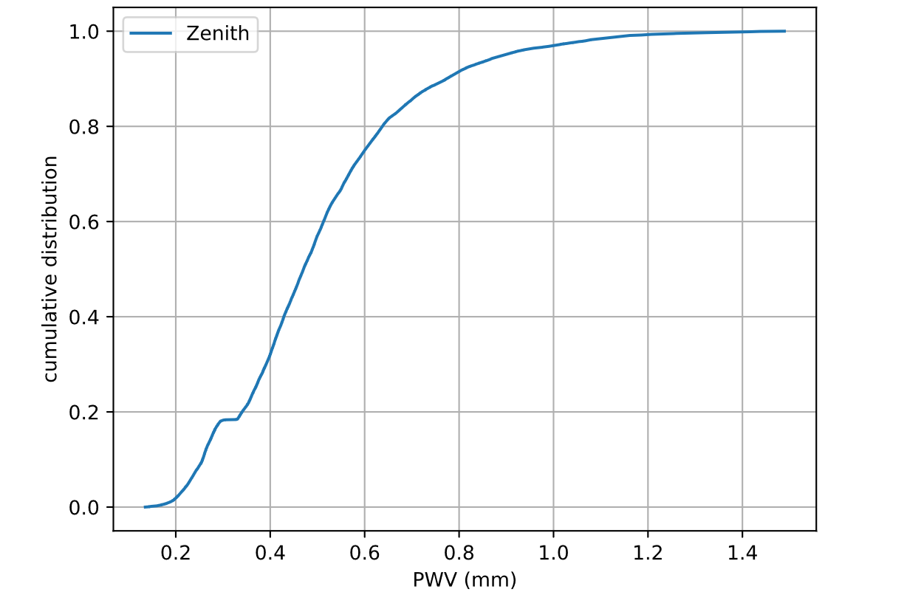
MERRA-2 data
AZ file
From: Kuo, 2017
Data from | 25% | 50% (median) | 75%
 | PWV(mm)
MERRA-2 | 0.231 | 0.321 | 0.448
AZ file | 0.368 | 0.470 | 0.600
Note: The data are excluding summer months, which is November–February for the Southern Hemisphere.

Slide 29
Data from | 25% | 50% (median) | 75%
 | PWV(mm)
MERRA-2 | 0.231 | 0.321 | 0.448
AZ file | 0.368 | 0.470 | 0.600

Slide 30
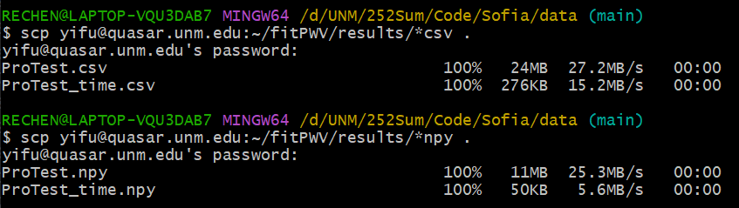
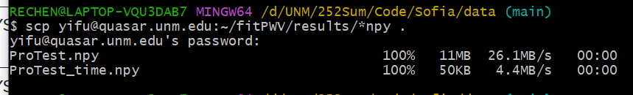
The Improved npy

Slide 31
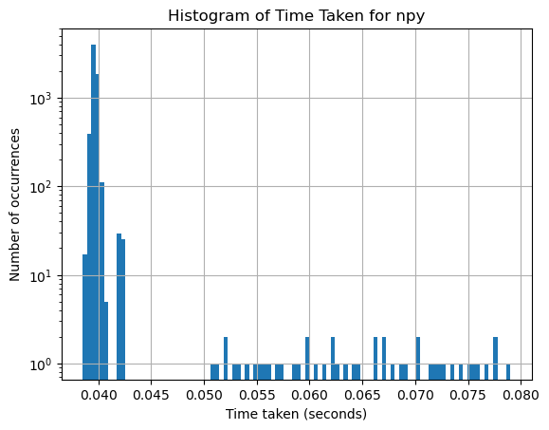

Slide 32
